Slide 1


FAO’s Perspective on Food Security as a Pillar of National Security
From Field to Sea – A Common Vision for EU Food Security and Strategic Autonomy
Dubrovnik, 28 September 2026
Raimund Jehle
FAO Regional office for Europe and Central Asia
Notes:
Distinguished Parliamentarians of the MED9 group, esteemed colleagues,
On behalf of the Food and Agriculture Organization of the United Nations, it is a privilege to address this timely conference in Dubrovnik. The core proposition of this segment—that defense security cannot be ensured without food security—is increasingly relevant. As Europe and NATO expand defense commitments, we must also ensure that foundational agrifood systems remain resilient, and that all people at all times have access to sufficient, safe, and nutritious food.

Slide 2


Food security is fundamental to national security and resilience
FOOD SECURITY
HEALTH & WELL-BEING
SOCIAL &
INSTITUTIONAL RESILIENCE
ECONOMIC STABILITY
Resilience ≠ self-sufficiency
+
+
+
Strong domestic capacity
Diversified supply
Functioning markets
Strong institutions
Reduce vulnerabilities and avoid single points of failure
Notes:
As food security is increasingly framed through national resilience and strategic autonomy, the key question is how to strengthen preparedness without closing markets or slipping into protectionism. Resilience is not autarky; it means keeping domestic and transboundary agrifood systems strong even when under stress.
This matters because food security is both a human right and a necessary condition for prosperous development and peace. When food becomes unavailable or unaffordable, the effects quickly move downstream, weakening public wellbeing, economies, social cohesion, and trust in institutions.

Slide 3


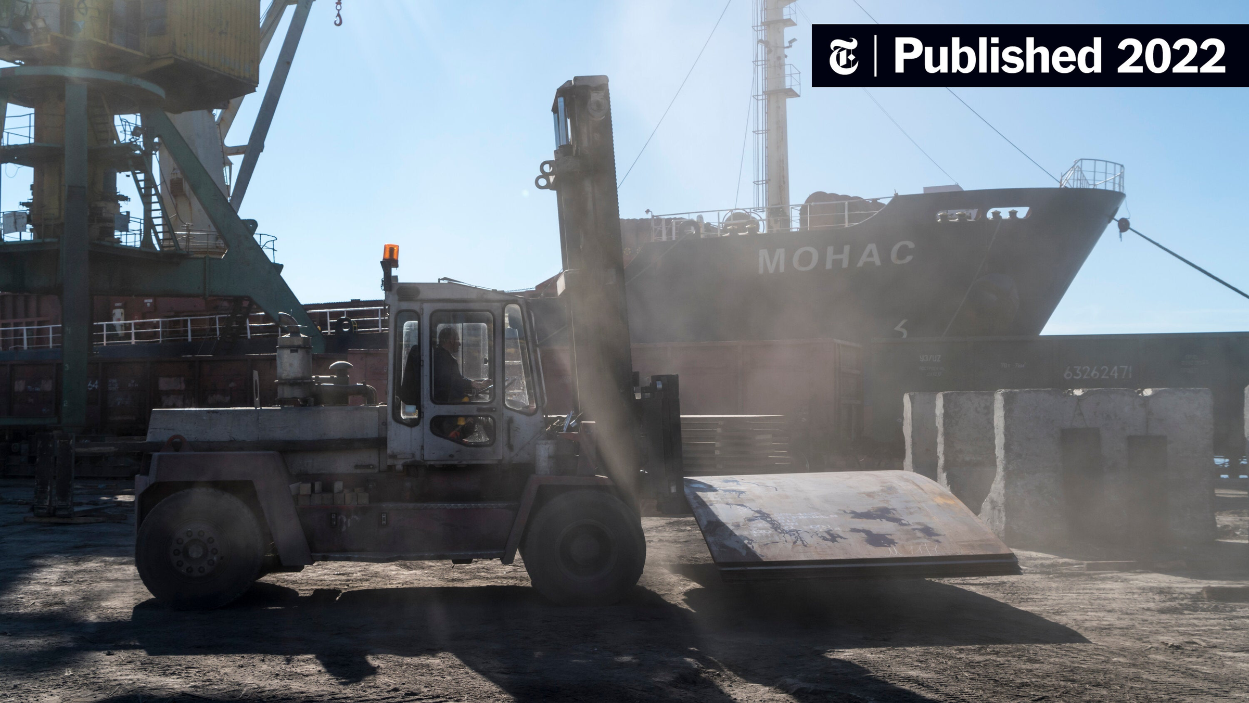
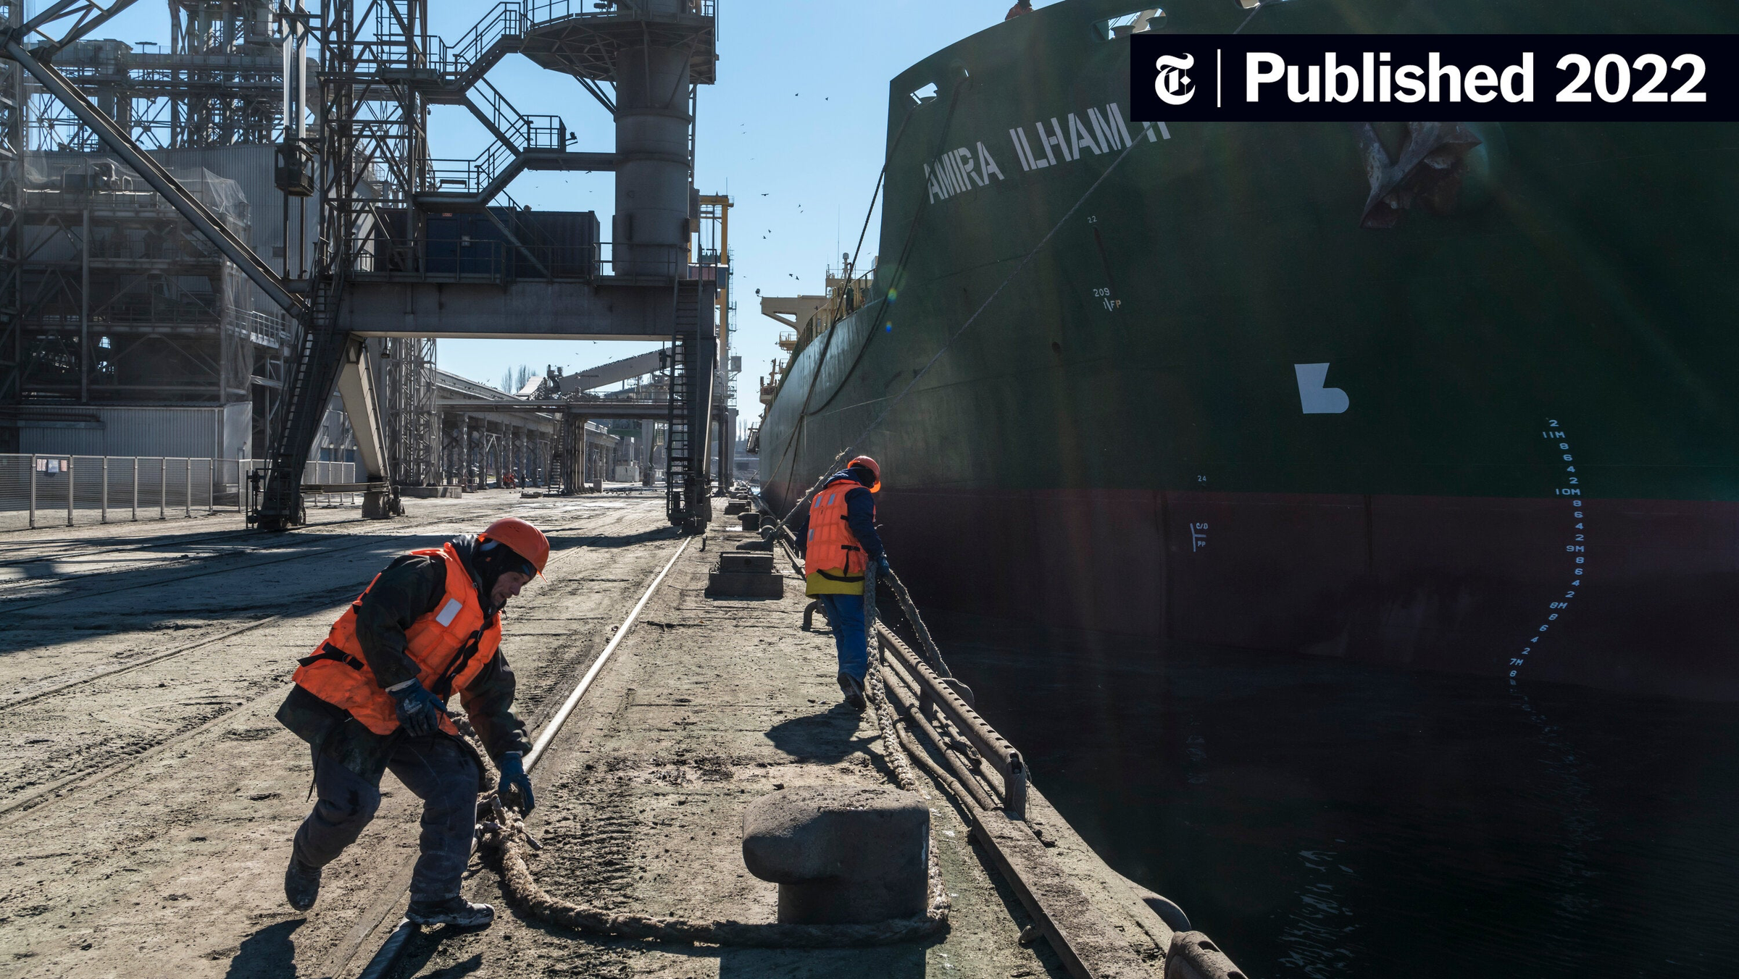
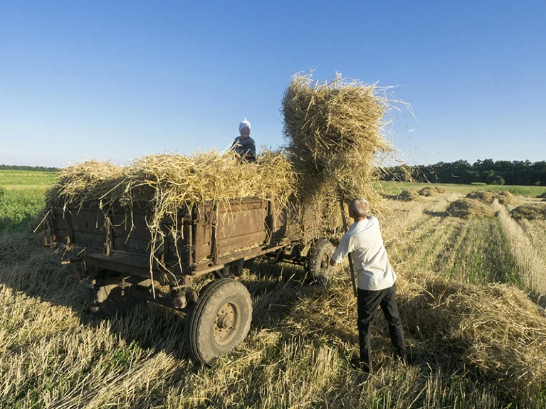
Recent crisis have exposed interconnected vulnerabilities
Shocks in one part of the food system can rapidly cascade across the entire agrifood chain
© CNN 2023
© NYT 2022
© NYT 2022
© Nature 2022
Strong institutions
Transparent markets
Social protection systems
Climate and environmental risks and natural hazards
Market disruptions and economic shifts
Conflict and displacement
Early
warning
Supply chain volatility
Notes:
Recent years have demonstrated how exposed our agrifood systems are to multiple and increasingly interconnected shocks.
Climate extremes, drought and water scarcity are affecting agricultural productivity and natural resources. Conflicts can destroy productive assets, displace rural communities and disrupt production and trade. Energy and input-price shocks affect production costs and food prices. And disruptions to transport and trade corridors can rapidly transmit shocks across countries and markets.
The Mediterranean is particularly exposed. Water scarcity, rising temperatures, soil degradation and increasingly frequent extreme weather events are placing growing pressure on agricultural production.
The important lesson is that these risks do not occur in isolation. Climate, geopolitical, economic and supply-chain shocks increasingly interact and reinforce each other.
A disruption that begins locally can therefore have consequences far beyond the sector or country where it originated.
Transition to slide 4 (new)
The question is therefore not whether another shock will occur, but whether our agrifood systems can continue to function when it does.

Slide 4
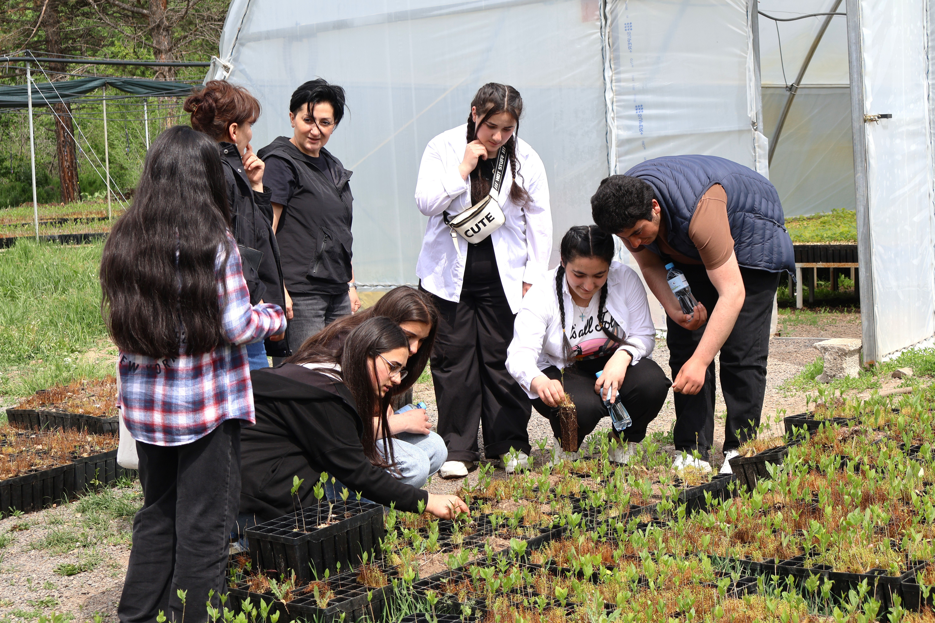

Resilience = keep the system function
Resource efficiency
Water, soil, and climate-smart production
  Diversification
  Production, Inputs and supply sources
Preparedness
Monitoring, contingency planning
  Strategic Buffers
  Reserves, storage and processing capacity
  Inclusion
  SMEs, farmers, fishers &local food enterprises
© FAO/Anna Poghosyan
Strategic reserves are one component of preparedness — not the resilience strategy itself.
Notes:
And this is what resilience means in practice: keeping the entire agrifood chain functioning under stress. Resource efficiency and sufficient domestic agricultural and fisheries production is essential, but production alone does not guarantee food security.
We need to look at the entire chain: water and soils, inputs, production, processing, storage, transport and logistics, functioning markets and, ultimately, access by consumers.
If one critical link fails, the consequences can affect the functioning of the entire system. This is why preparedness requires risk monitoring and contingency planning, diversification of production and supply sources, and sufficient processing, storage and logistical capacity.
Strategic reserves can provide an important buffer during severe disruptions, but they are one component of preparedness — not the resilience strategy itself. Their effectiveness ultimately depends on functioning markets, storage, transport and distribution.
And we should not overlook farmers, fishers, small and medium-sized enterprises and local processors. Their integration into resilient value chains can diversify production and supply, strengthen local processing capacity and reduce single points of failure.
So the objective is clear: identify vulnerabilities across the entire chain before a crisis occurs and build the capacity to keep its critical functions operating when shocks come.
Transition to the next slide:
But many of these critical functions and vulnerabilities do not stop at national borders. National food-security resilience therefore also depends on regional cooperation.

Slide 5


Managing transboundary risks through regional cooperation
Trade corridors and continuity of food and input flows
Shared water, marine ecosystems and transboundary biosecurity risks
One Health, food safety and information sharing
Regional early warning and coordinated response
© FAO/Anna Poghosyan
Notes:
But even the strongest national food system cannot manage all risks alone.
Many of the critical dependencies we have just discussed are inherently transboundary.
Food and agricultural inputs move through international trade corridors. Water resources and marine ecosystems are shared. Animal diseases, zoonotic threats, plant pests and food-safety risks cross borders. And disruptions in one country or along one major trade route can rapidly affect markets and food supplies elsewhere.
This is particularly important in the Mediterranean, where countries are closely connected through trade, shared natural resources, marine ecosystems and common biosecurity risks.
Regional cooperation must therefore complement national preparedness. This means maintaining reliable and diversified trade and supply routes; strengthening cooperation on One Health, animal and plant health and food safety; sharing information and early warning; and managing shared water and marine resources sustainably.
Regional cooperation is not an alternative to national resilience — it is one of its foundations.
Transition to investment:
But cooperation and preparedness need to be backed by investment. The next question is therefore: which critical agrifood functions must continue operating during a crisis, and are we investing today to make them resilient?

Slide 6
Invest today in critical agrifood resilience
WHAT TO INVEST IN
WHAT TO INVEST IN
HOW TO FINANCE IT
Critical agrifood functions
National preparedness
Critical functions continue
under stress
National & EU investment
Climate finance
Multilateral Development Banks
Blended finance
Water & irrigation
﻿﻿Production & processing
﻿﻿Storage & cold chains
﻿﻿Ports, transport & logistics
﻿﻿Energy, laboratories & early warning
Economic stability
Lower disruption and
recovery costs
Long-term resilience
Stronger productive capacity
© FAO/Anna Poghosyan
Investments in agrifood resilience deliver in normal times — and protect critical functions in times of crisis
FAO: identify critical functions • assess vulnerabilities • support investment planning
Notes:
Resilience requires investment before a crisis occurs. The starting point is to identify which critical agrifood functions must continue operating under stress — and where the vulnerabilities and single points of failure lie.
This goes well beyond food storage. It includes water and irrigation systems, resilient production, processing and storage, cold chains, ports and logistics, reliable energy, laboratories, biosecurity and early-warning systems.
Importantly, these investments generate benefits in normal times as well as during emergencies. They strengthen productivity and economic stability while also increasing national preparedness and long-term resilience.
Financing therefore needs to come from multiple sources — national and EU investment, climate finance, multilateral development banks and blended finance.
How particular investments are classified under security or defense expenditure frameworks is for the competent authorities to determine.
FAO can help countries identify the critical agrifood functions, vulnerabilities and investments required to strengthen food-security resilience.
Transition to Parliamentary Action:
Identifying these priorities and mobilizing finance is only part of the equation. Turning them into sustained national preparedness requires political choices — and this is where parliaments have a particularly important role.

Slide 7




Parliamentary action: four levers for food-security resilience
1
2
3
4
LEGISLATE
INVEST
OVERSEE
COOPERATE
Embed food security in national preparedness
• Whole-of-system risk assessment
• Contingency and continuity planning
Prioritize critical agrifood functions
• Water, production and processing
• Storage, logistics and early warning
Ensure preparedness
is operational
• Evidence-based strategic reserves
• Transparency, monitoring and accountability
Strengthen regional resilience
• Trade and information sharing
• Water, One Health and biosecurity
Parliaments can turn resilience priorities into sustained national preparedness

Slide 8


FAO stands ready to support
MED9 countries and parliaments
Thank you
Notes:
Food security is not an isolated agricultural issue; it is a pillar of national resilience, sustainable development, statecraft, and economic stability. FAO stands ready to partner with MED9 countries and parliaments to build a secure, resilient, and sustainable future.

